Slide 1
Some common operations on matrices

Slide 2
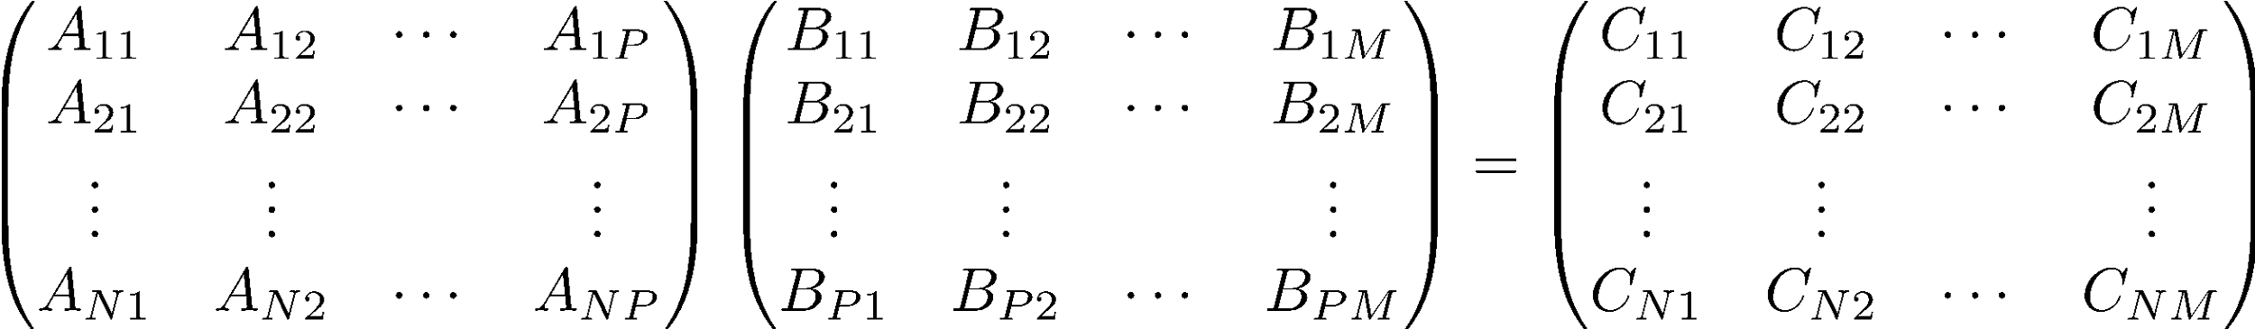
Product of 2 Matrices
N X P
P X M
N X M
‘inner matrix dimensions must agree’
Note: Matrix multiplication doesn’t (generally) commute, AB ≠ BA

Slide 3
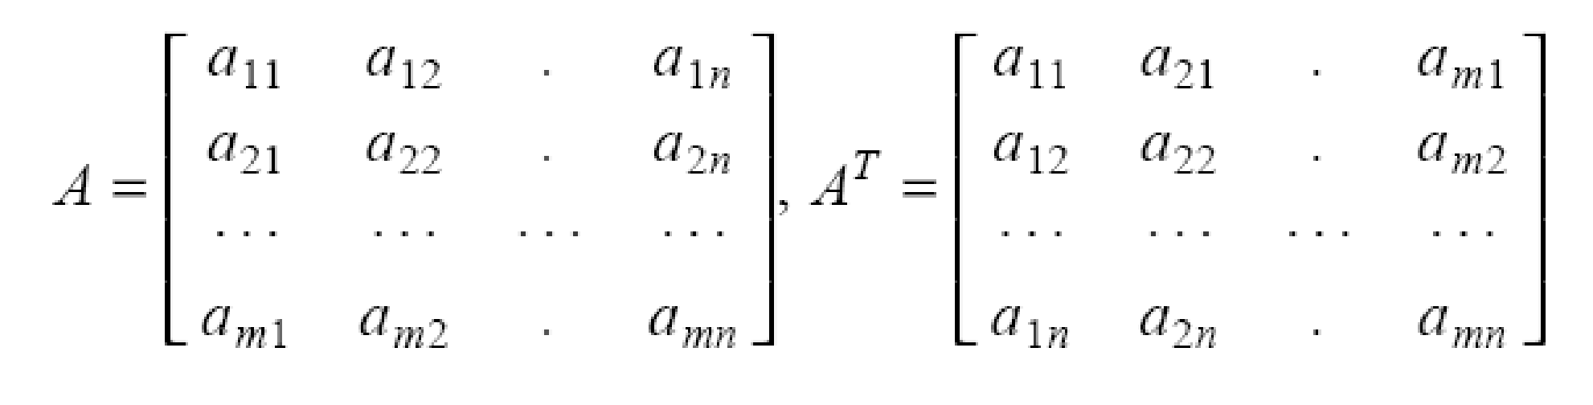
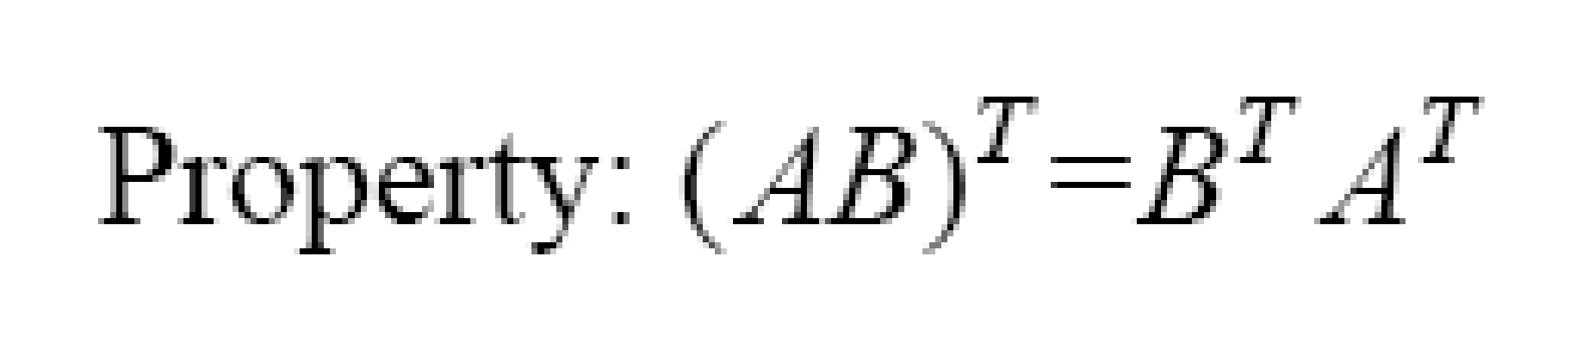
Matrix Transpose

Slide 4
Eigenvectors & eigenvalues

Slide 5
Eigenvectors
A nonzero vector x is an eigenvector (or characteristic vector) of a square matrix A if there exists a scalar λ such that Ax = λx. Then λ is an eigenvalue (or characteristic value) of A.

Slide 6
Eigenvalues
Let x be an eigenvector of the matrix A. Then there must exist an eigenvalue λ such that Ax = λx or, equivalently,
Ax - λx = 0 or
(A – λI)x = 0
det(A – λI) = 0
This is called the characteristic equation of A. Its roots determine the eigenvalues of A.

Slide 7
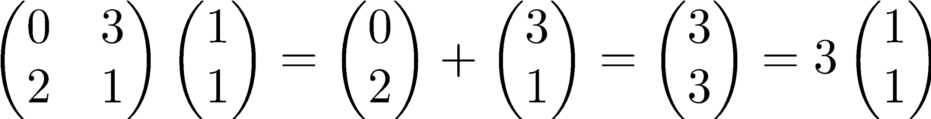


Are there any special vectors that only get scaled?
For this special vector, multiplying by M is like multiplying by a scalar.
(1,1) is called an eigenvector of M
3 (the scaling factor) is called the eigenvalue associated with this eigenvector
= (3,3)
= (1,1)

Slide 8
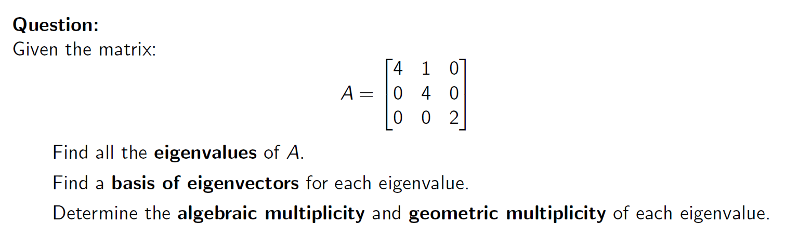
Example: Eigenvalues and Eigenvectors of a 3 × 3 Matrix

Slide 9
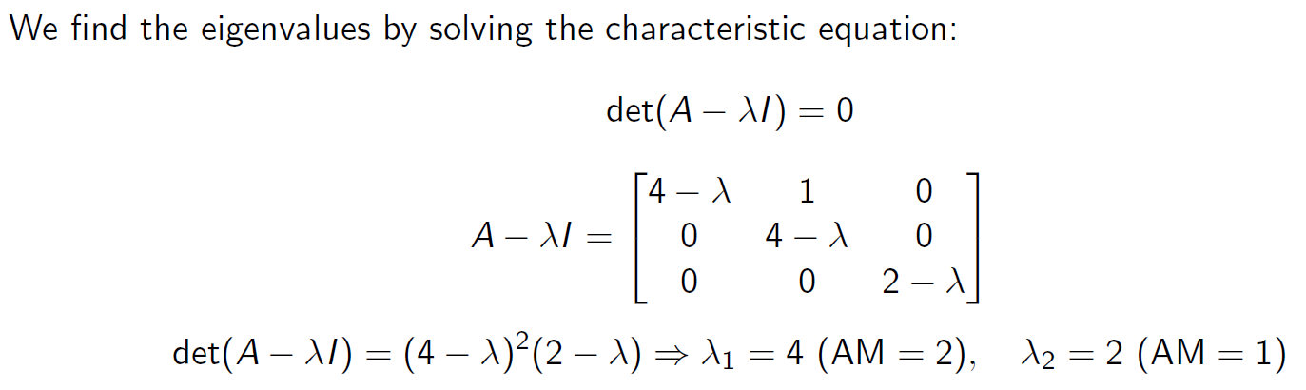
Step 1: Characteristic Equation

Slide 10
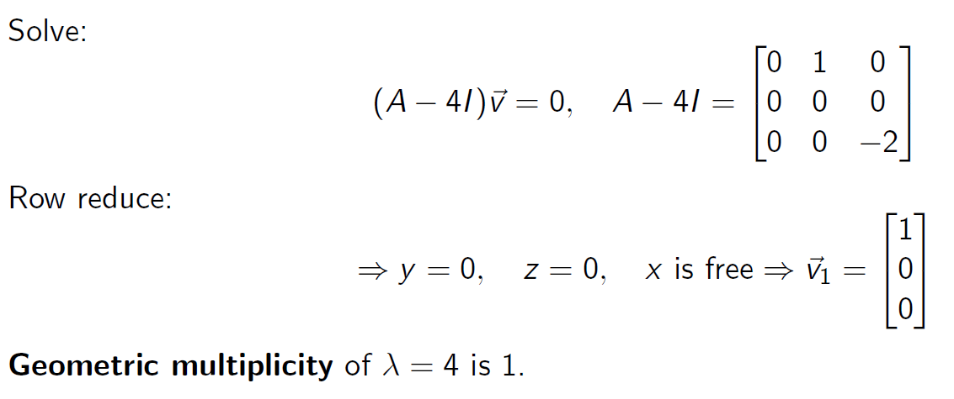
Step 2: Eigenvectors for λ = 4

Slide 11
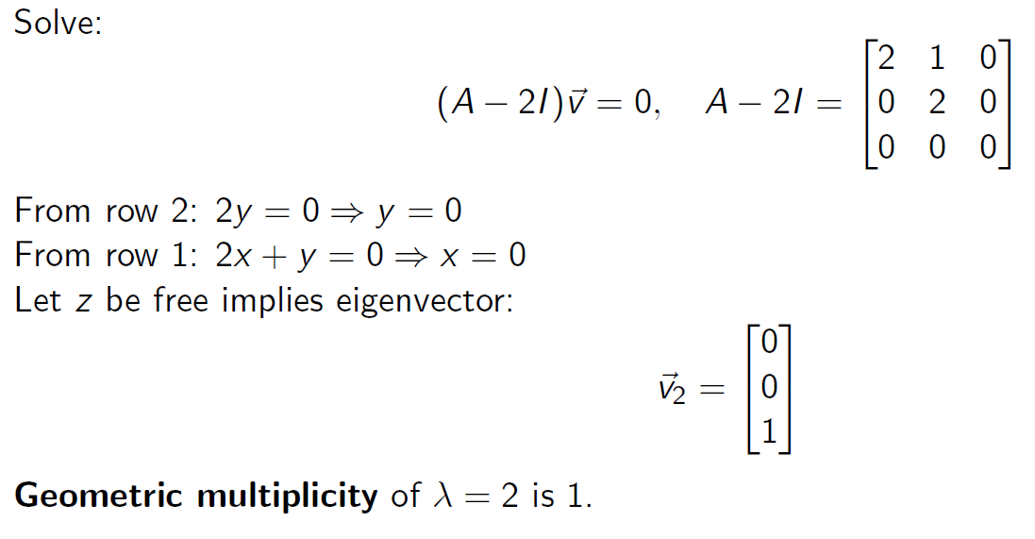
Step 3: Eigenvector for λ = 2

Slide 12

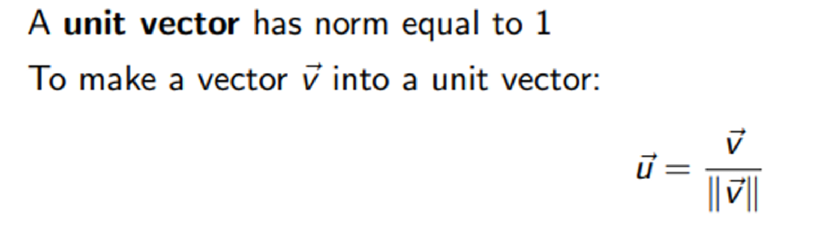

Slide 13
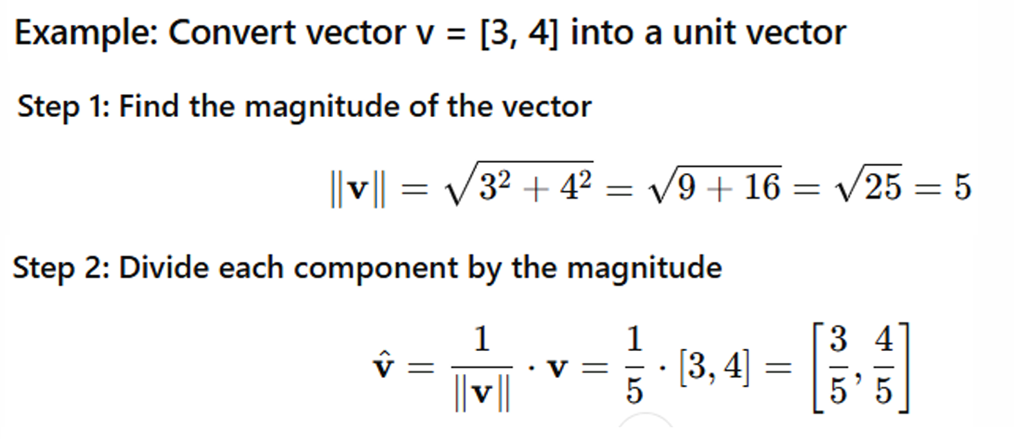

Slide 14
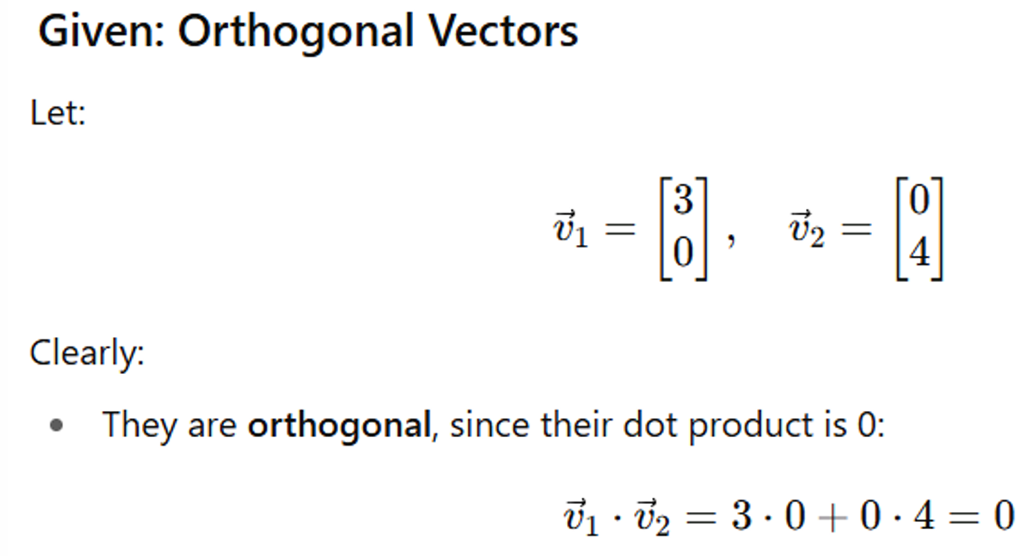

Slide 15
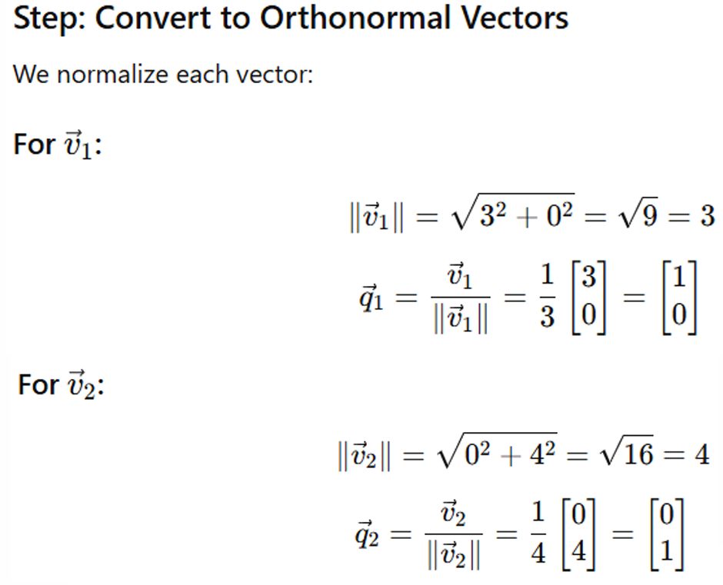

Slide 16
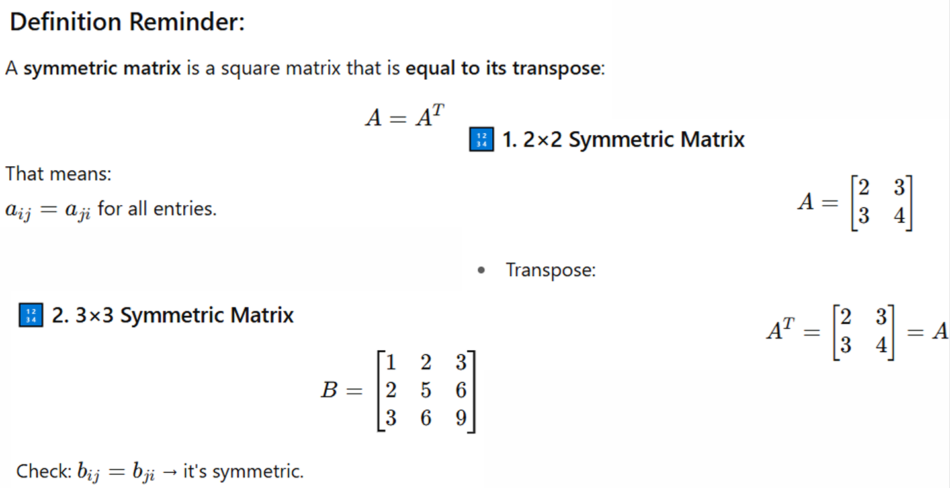

Slide 17
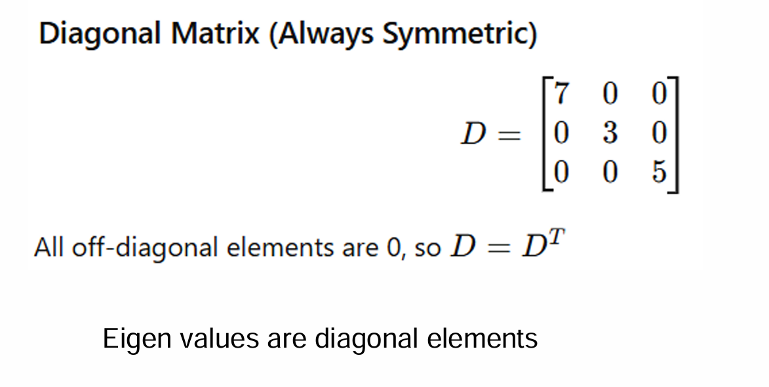

Slide 18
